Slide 1

Intrusion detection and counter measure virtual cloud systems-state of art and challenges
By
AJAY KUMAR GADDE

Slide 2
CONTENTS
ABSTRACT
INTRODUCTION
OVERVIEW OF CLOUD TECHNOLOGIES
CLOUD Vulnerabilities
INTRUSION DETECTION TECHNIQUES IN CLOUD
DISTRIBUTED DENIAL OF SERVICE (DDOS) ATTACKS AND TRADITIONALCOUNTER MEASURES
VM COMMON SECURITY VULNERABILITIES AND
DEFENCE MECHANISMS
IDPSS IN THE CLOUD
SYSTEMS FOR DEFENDING AGAINST DDOS IN THE CLOUD
SUMMARY OF FEATURES – DDOS CLOUD PROTECTION SYSTEMS
CONCLUSION

Slide 3
ABSRACT
Clouds are distributed Internet-based platforms that provide highly resilient and scalable environments to be used by enterprises in a multitude of ways.
Security is one of the major concerns that is of practical interest to decision makers when they are making critical strategic operational decisions.
Distributed Denial of Service (DDoS) attacks are becoming more frequent and effective over the past years
security issues related to DDoS and virtualization with a focus on structure, clarity, and well-defined blocks for mainstream cloud computing security solutions and platforms
intrusion detection and prevention mechanisms that can be part of an overall strategy to help understand identify and mitigate potential DDoS attacks on business networks.

Slide 4
inroduction
Cloud computing is a growing facet of the technical infrastructure of modern information systems.
It provides a way to deliver the demand of users for near consistent access to their data and software resources regardless of their physical position.
The cloud model reduces industrial costs by simplifying the process of installing hardware and software updates and ensuring availability and adaptability of computing resources as required.
The cloud computing model maintaining a certain level of trust between clients and providers to ensure that client’s data is secure and that an agreed Quality of Service (QoS) is provided at all times.
This paper aims to investigate the latest defensive systems proposed for use against DDoS attacks targeting the cloud model.

Slide 5
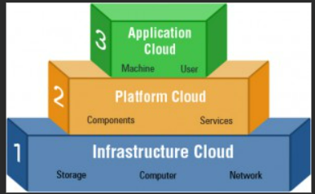
Cloud Architecture
The infrastructure layer: Also called the virtualization layer , the infrastructure layer is where all the servers are pooled together into one.
The platform layer :The platform layer comprises the operating system and other requisition structures and is based over the infrastructure layer.
The application layer: As the name suggests, the application layer - the topmost layer - contains applications that directly interact with the end-user.

Slide 6
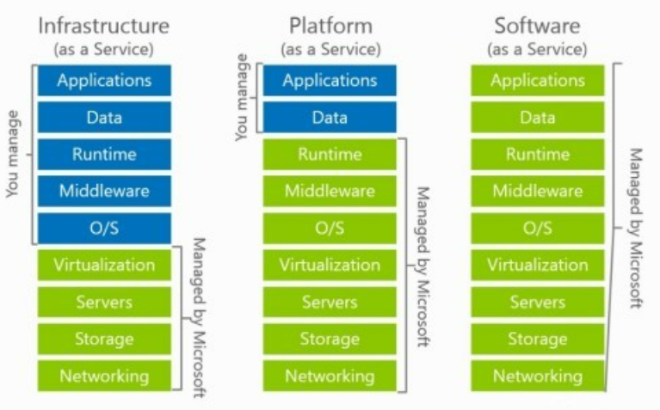
SERVICE DEPLOYMENT MODELS
service deployment models of cloud computing​
Infrastructure as a Service (IaaS) ​
Platform as a Service (PaaS) ​
Software as a Service (SaaS) ​

Slide 7

Cloud Vulnerabilities
The openness, elasticity, and amount of data stored in clouds make them attractive targets for attackers.
technological regions also brings with it the security issues associated with each of these areas.
networks were less distributed, making defense mechanisms focused on insider attacks
In the cloud computing paradigm, security responsibilities are passed to an outside agency.
This paper pays particular attention to the vast increase in the number of DDoS attacks.

Slide 8
INTRUSION DETECTION TECHNIQUES IN CLOUD
Intrusion detection is the first step in identifying a malicious behaviour against a system
There are two standard approaches used by Intrusion Detection Systems (IDS), these are
knowledge-based intrusion detection :Knowledge-based systems must possess an attack description, typically a signature that can be matched to attack manifestations. Signatures range from simple pattern matching to network packets
The usability of these systems is dependent on the False Alarm Rate (FAR) that they generate, which is made up of both false-positive alarms (raising an alarm for legitimate traffic) and false-negatives (the failure to register an intrusion attacks).

Slide 9
KNOWLEDGE BASED IDS
Knowledge-based systems must possess an attack description, typically a signature that can be matched to attack manifestations. Signatures range from simple pattern matching to network packets
Used for identifying previously known attacks
Attack signatures stored in databases.
Simple to implement.
Require frequent updates to maintain security level.
Slow to react to new attacks, as new behaviours signatures need to be added to the relevant databases.

Slide 10
ANONAMLY BASED IDS
Monitors network attributes.
Assumes that malicious network behaviour is noticeably different to regular behaviour.
Able to detect unknown attacks.
The usability of these systems is dependent on the false alarm rate.
Requires a system-training period. The training period needs to be carefully selected to represent standard network behaviours.
Data analysis tools, such as Hadoop, can be used to create models and monitor real-time behaviour

Slide 11
IDSs Classification and Challenges
In general, IDS systems designed for cloud computing can be classified into four main categories
Host-based IDS (HIDS)
Network-based IDS (NIDS):
Hypervisor-based IDS (HyIDS):
Distributed IDS (DIDS)

Slide 12
DDOS ATTACKS AND TRADITIONAL COUNTERMEASURES
The most common attack vector that has been used to attempt to adversely affect cloud services is DDoS attacks.
A DDoS attack aims to render the computing resources of the victim unavailable by modifying the system configuration or by sending it too high workload.
DDoS attacks can be divided into two general categories,
application level attacks
infrastructure level attacks.

Slide 13
The most common DDoS defence approaches combine elements located in the source-end and victim-end in to combine their advantages.
The source-end is the location from which the attack is launched; this is the best place to intercept an attack as it causes the least disruption to legitimate traffic.
D-WARD is a system that employs a firewall at the source end.
DDoS traffic is easier to identify at victim-end points. IDPS at these points are effective at generating attack signatures, which they can then be used by upstream routers to rate-limit or filter traffic.
However, by this point the bandwidth of the network could be saturated. Moreover, these infrastructural approaches require the cooperation of multiple Internet Service Providers (ISP) to cover the required range of administrative domains.

Slide 14
VM COMMON SECURITY VULNERABILITIES AND
DEFENCE MECHANISMS
Virtualisation is the key underlying technology of the cloud computing model
security needs to be considered as the foundations of any proposed system. Particularly, the fundamental weaknesses in the VM architecture need to be addressed to enhance security across other layers.
Isolation is the key security feature to protect VMs from malicious attacks.
The isolation-based defence approaches can be split into those that isolate the running of VMs and those that focus on the isolation of shared resourceVM Monitor
a framework for enhancing VMs security in clouds using module measure

Slide 15
IDPSS IN THE CLOUD
IDS and IDPS face difficulties when transferred from traditional networks to cloud-based designs.
The latest developments in IDPSs are investigated in this section
Time Delay Neural Network (TDNN) model to defend against probe or reconnaissance attacks.
system to prevent SQL injection in cloud computing web-based systems using signature-based approaches.
Most current Intrusion Response Systems (IRS) use static matching to decide a suitable response action to an attack.
VM Monitor based IPS to monitor network flow and file integrity in real-time.

Slide 16
SYSTEMS FOR DEFENDING AGAINST DDOS IN THE CLOUD
DDoS attacks can render CSPs unable to provide their users with the service as outlined in their QoS documents and/or they have their resources manipulated to launch an attack against external targets
section builds on the knowledge of the cloud architecture and IDPSs to analyse proposed systems aimed at protecting the cloud against DDoS attacks
The current packet tracing methods of Probabilistic Packet Marking (PPM) and Deterministic Packet Marking (DPM) will become ineffective with the introduction of IPv6.
trace-back and filter system to protect the cloud from DDoS attacks.
trace-back is implemented by adding a tag to Service Orientated Architectures (SOA) packets to record the route taken.

Slide 17
This method is rather limited in its effect to counter DDoS attacks, because the tag is only added to the packet once it is relatively close to the server. When an attack is launched via the Internet, SOA packet tracking does not provide enough information to identify the source of the attack.
Another trace-back model is DPM and training data to inform the filters in a neural network.
The future of DPM may be limited with the introduction of IPv6 and the fact that trace-back tags can only be introduced once a packet is within the cloud network.
This system has a success rate of correctly identifying approximately 75% of attack traffic
It has a significant time variation in the detection rate of attack traffic from 20ms to 1s; an overhead that may cause disruption to legitimate users when accessing systems even if an attack is not taking place.
Another application layer DDoS IDPS specifically designed to deal with Low and Slow (LOS) attacks
These attacks are rarely detected using pattern matching or threshold measuring techniques given their low resource consumption approach.

Slide 18
low reflection ratio mitigation system to be deployed in front of the IaaS. The system consists of Source Checking, Counting, Attack Detection,
Turing test and Question Generation modules. In the implementation of their defence system, the authors take into account the challenges of computational efficiency and overheads and their effect on legitimate users.
This approach requires less bandwidth than the more traditional image-based puzzles, such as CAPTCHA.
A blacklist, whitelist, block list and unknown are used to categorise incoming packets based on IP addresses
These lists are maintained by administrators through APIs.
The use of these APIs opens the system to malicious manipulation from insiders. Although this system uses the cloud capabilities to provide protection against bottlenecks, it incurs an operational degradation of 8.5% when monitoring traffic against a blacklist of 100000 addresses.

Slide 19
SUMMARY OF FEATURES – DDOS CLOUD PROTECTION SYSTEMS
Different attacks are listed with their corresponding response mechanisms.
The recent solutions for various security issues are also grouped into logical categories to make gaps in the literature more obvious.

Slide 20
CONCLUSION

